Slide 1














ThoughtSpot Embrace
Version 6.3
© ThoughtSpot Inc 2019

Slide 2
Learning Objectives
Review evolution of data management market
Understand benefits and common use cases of Embrace
Review key features of Embrace
Set up connection with source database
Edit or remap your connection
Link and search data
Notes:
What is Embrace? A major feature in ThoughtSpot through which a user can query data directly in an external DB or system without loading the data in TS.

Slide 3
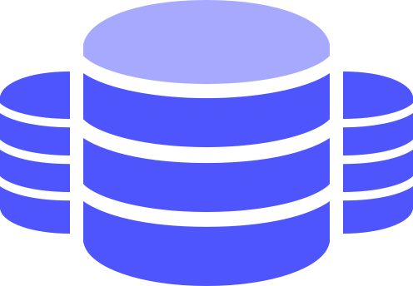


Evolution of Data Management Market
Traditional Enterprise Data Warehouse
Data Lakes
Modern Cloud Data Warehouse
Rigid, tabular structured data, ETL/ modeling needed
Semi & unstructured data,
Management overhead
Easy to manage, elastic, low cost
Notes:
Modern cloud data warehouse 1) Optimized for analytics, 2) Easy to manage/customers can easily scale up or down (lower cost), 3) MPP architecture (large amounts of data can be processed quickly, high performance in search)

Slide 4


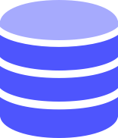









Integrated Architecture
RELATIONAL
SEARCH
PINBOARDS
EMBEDDED & APIS
AUTOMATED INSIGHTS
MOBILE
BUSINESS MONITORING
INSIGHTS
FEED
SEARCH ENGINE
SPOTIQ AI ENGINE
PERSONALIZATION ENGINE
DISTRIBUTED CLUSTER MANAGER
ENTERPRISE SECURITY &
GOVERNANCE
BI & VISUALIZATION SERVER
IN-MEMORY CACHE
EMBRACE - LIVE QUERY
DATA LOAD
On-prem EDW & DB
Data Lake
Apps (Salesforce, Marketo, etc.)
CSVs
Built from the ground up for search, designed for flexibility

Slide 5


Flexible Data Connectivity
In-memory Database
Embrace
BI Layer
BI Layer
Live-Queries
Falcon
External data warehouse
Notes:
With ThoughtSpot Embrace,
it’s easy to connect to your Snowflake data in just a few clicks
Business people easily find granular insights using an easy search experience that is familiar to them
And with the power of live queries that run directly in Snowflake, you get answers on your most up-to-date data, since there is no batch update or data caching that is required.

Slide 6
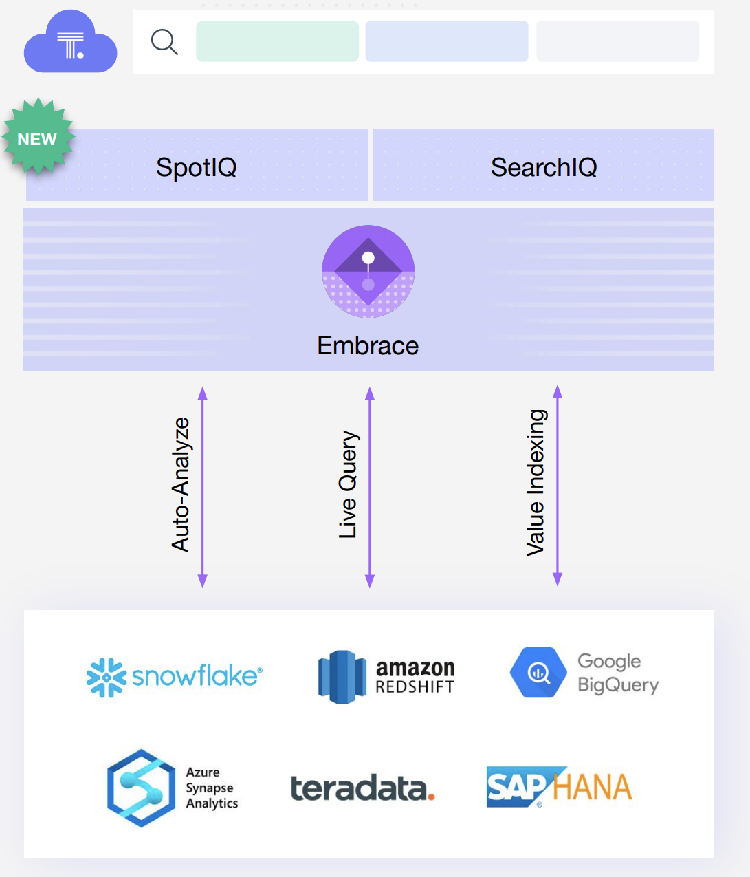
Embrace Key Benefits
Set up and deploy ThoughtSpot quickly by connecting directly to the external database
No need to move data into ThoughtSpot
Save time and money by avoiding ETL pipelines
Quick POC of use cases
Quick time to insight
Notes:
Set up and deploy TS quickly- this can be useful for a quick POC. A customer may want to try out ThoughtSpot, but would not want to move their data into the internal database. All the complexities of loading data into ThoughtSpot do not apply. It is also helpful for when you have a huge data warehouse (30-40 terrabytes), or you have lots of business logic built in already.
No need to move: If have a huge data warehouse (30-40 terrabytes: you can’t bring that in), or if you have lots of business logic in there
Save time and money: real time data, eliminate ETL pipeline (don’t recommend caching more than hourly)

Slide 7
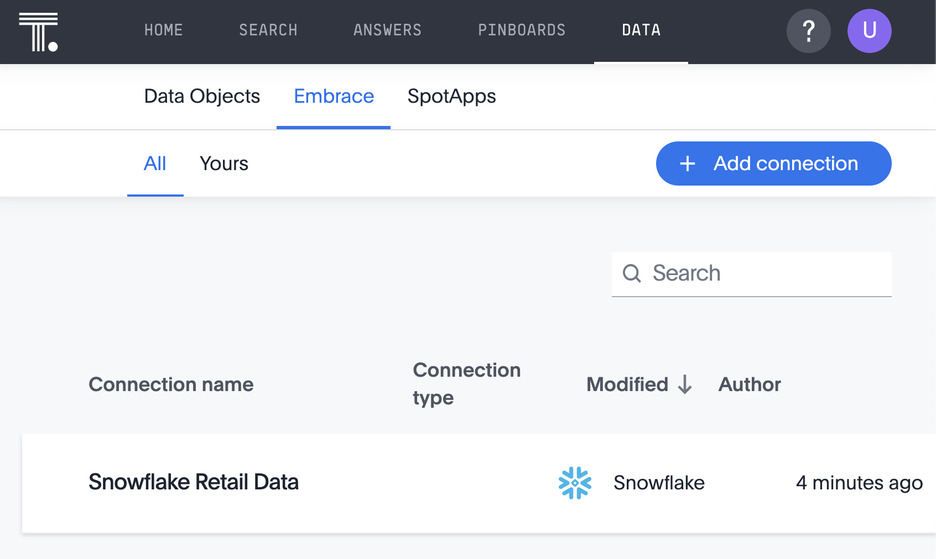
Connect to your data
Create a live connection to your data
1
2
Click Data from the top navigation bar
Click the Embrace tab to view existing connections
Click Add Connection
3
Notes:
This process only needs to be done once, and then your users can search this data anytime!

Slide 8
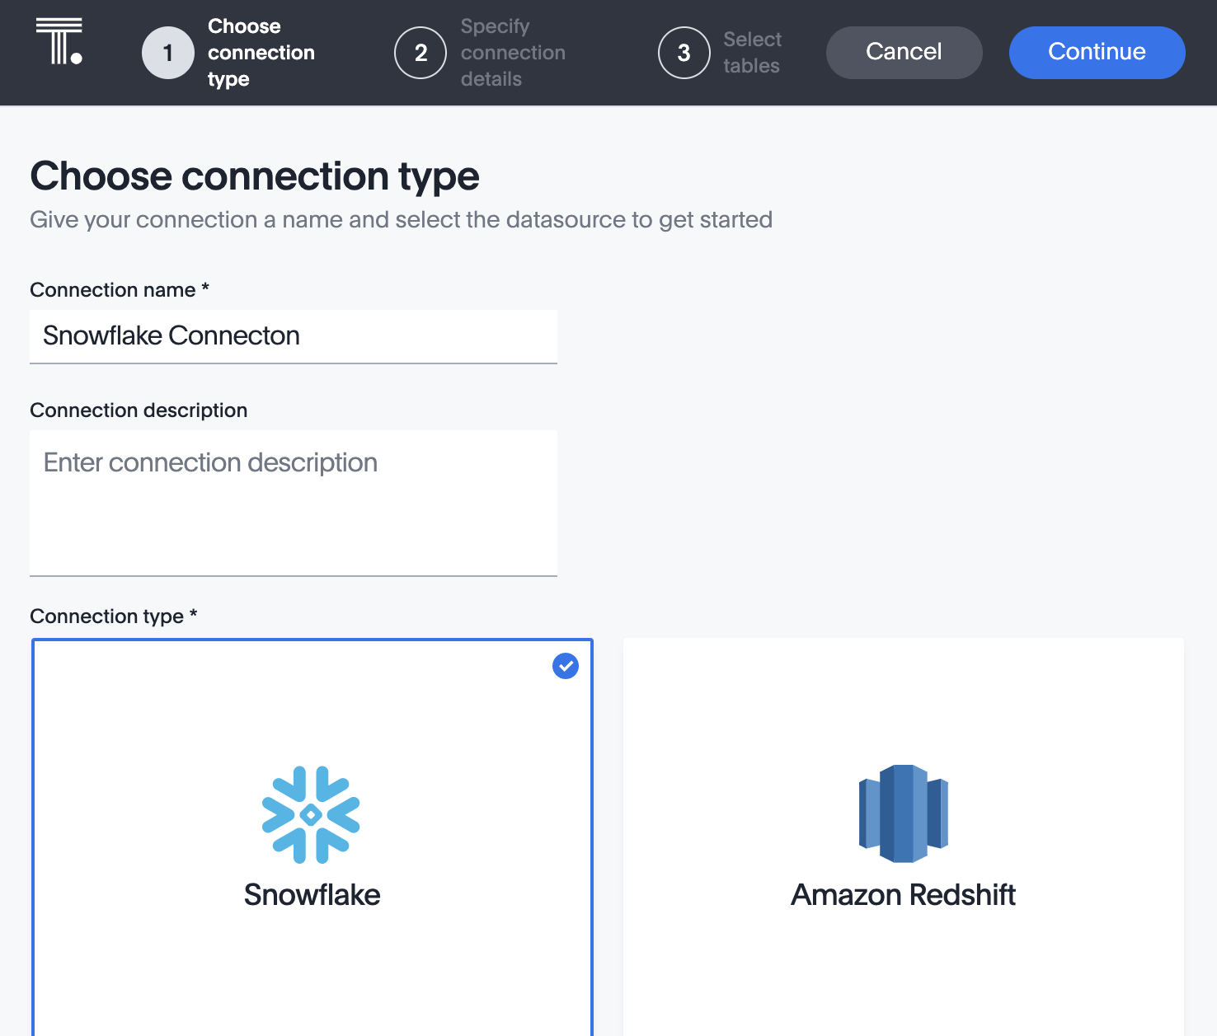
Connect to your data (cont.)
Choose your cloud data warehouse
3
Name your connection
Optionally, enter a description
Select your cloud data warehouse
Click Continue
1
2

Slide 9
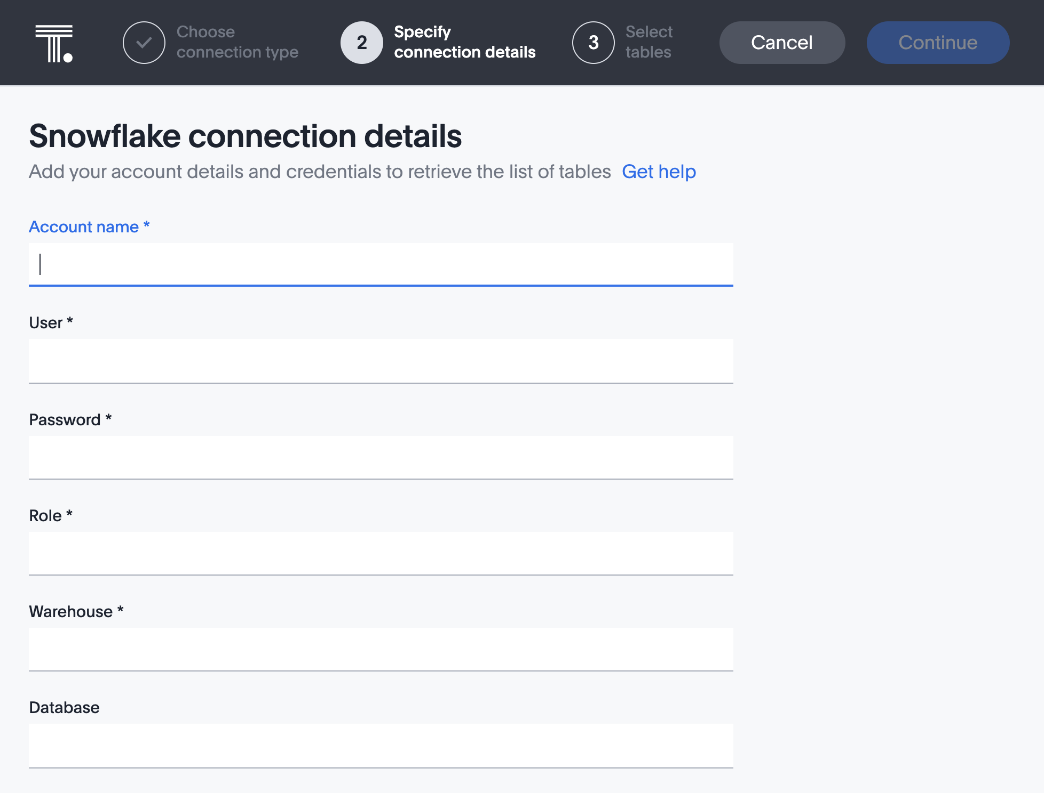
Connect to your data (cont.)
2
Enter Connection information
1
Complete all fields shown
To connect to all databases in one connection, leave the Database field blank

Slide 10
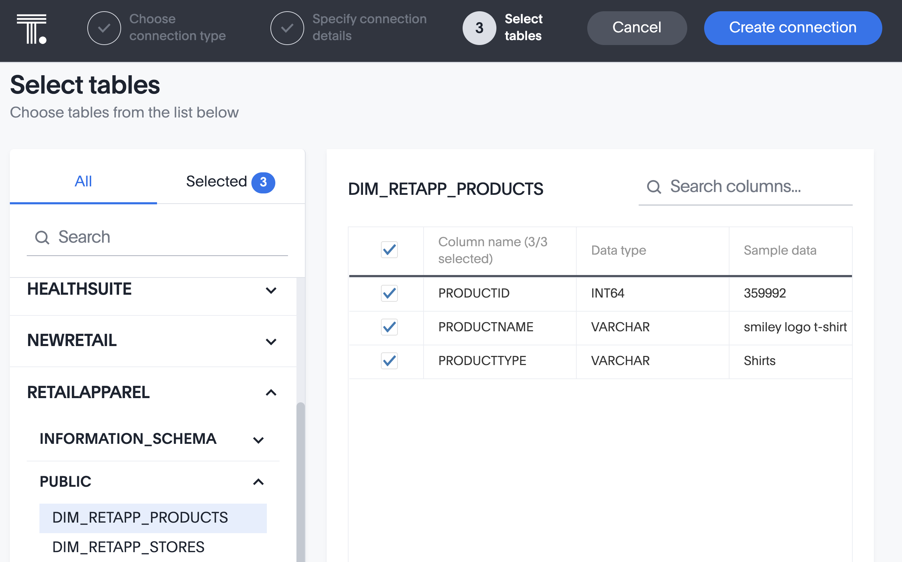
Connect to your data (cont.)
Select your tables and columns
3
Select table(s) from the left panel
Select which columns from the tables to include in the connection
Create your live connection!
2
1

Slide 11
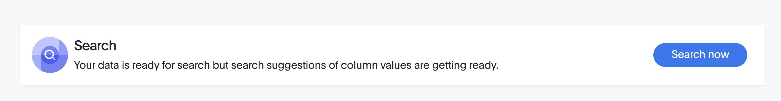
Searching your linked data
Search data immediately, while search indexing completes. ThoughtSpot re-indexes columns daily; this can be changed to an hourly schedule.
Even with an Embrace connection, you will see search suggestions of columns in the search bar as you type.
Create Worksheets, Views, Formulas, and more, from these connected tables!
Notes:
Users can immediately start searching on those tables, and create a Worksheet from them. Search indexing must be turned on for columns for search suggestions to appear as user to types in search bar.

Slide 12
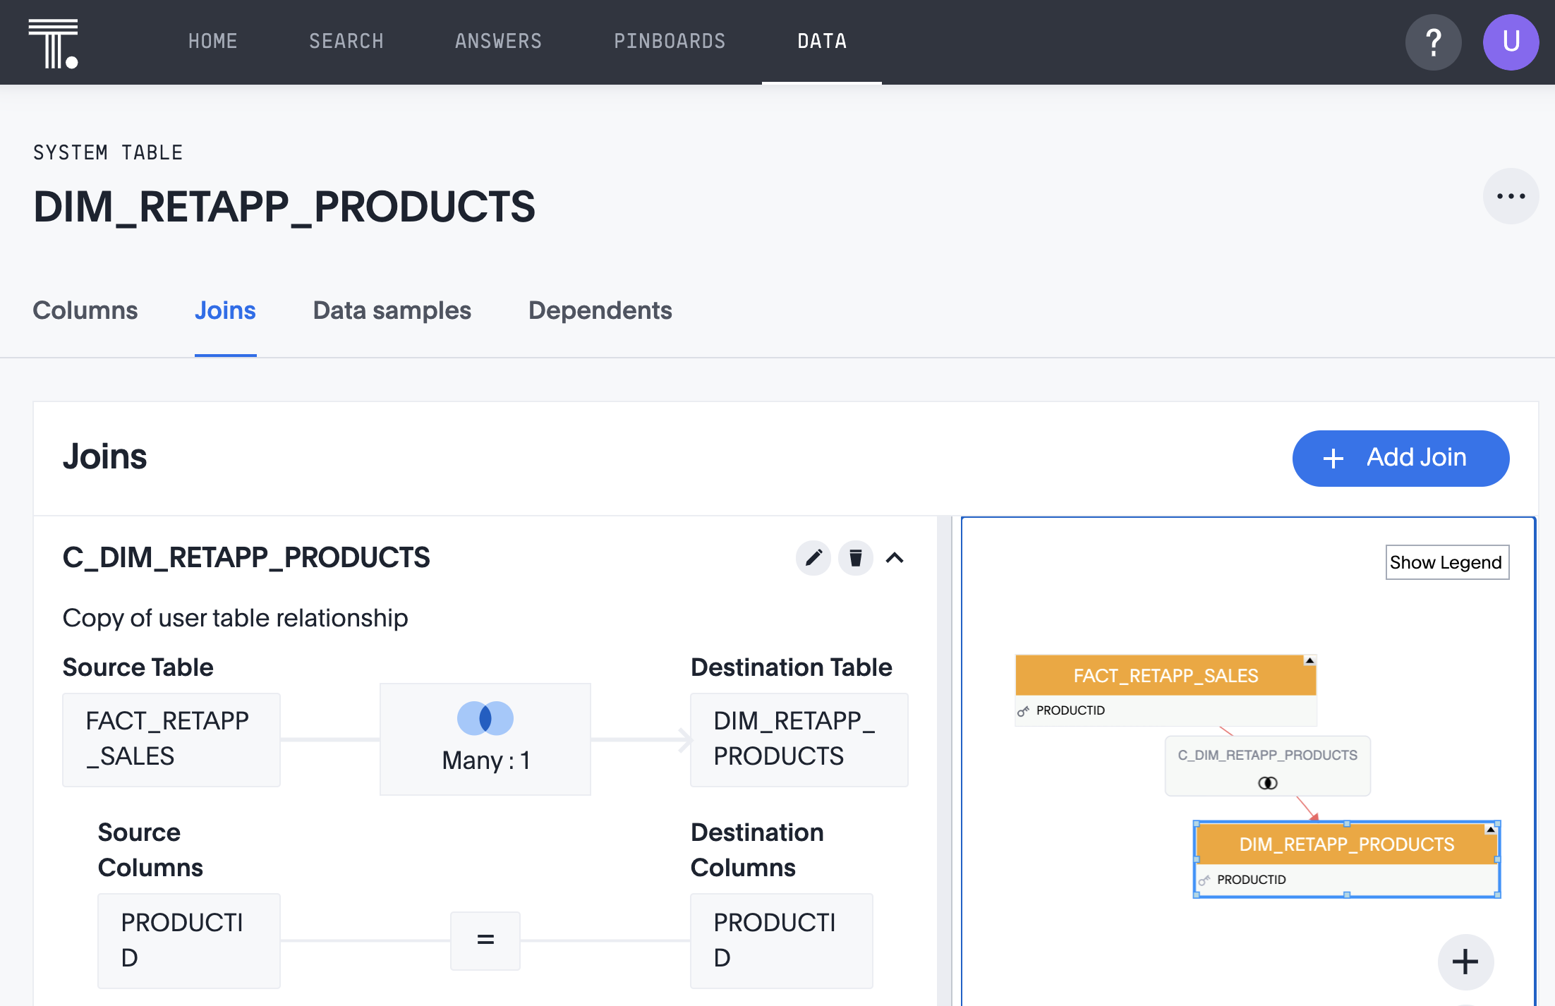
Table Join Relationships
View or Add Joins
2
If your tables were already joined in the data warehouse, no need to join them again!
Add a join by opening the table from the Data page, then clicking the Joins tab
View, re-name, or add a Join
1
3
Notes:
Joins that exist in the external data warehouse are carried over into ThoughtSpot. If tables need to be joined (i.e. they were not joined in the source data warehouse), join them in ThoughtSpot. The join type can be changed when creating a worksheet. Changes to join relationships that take effect after the initial connection is created must be edited in ThoughtSpot.

Slide 13
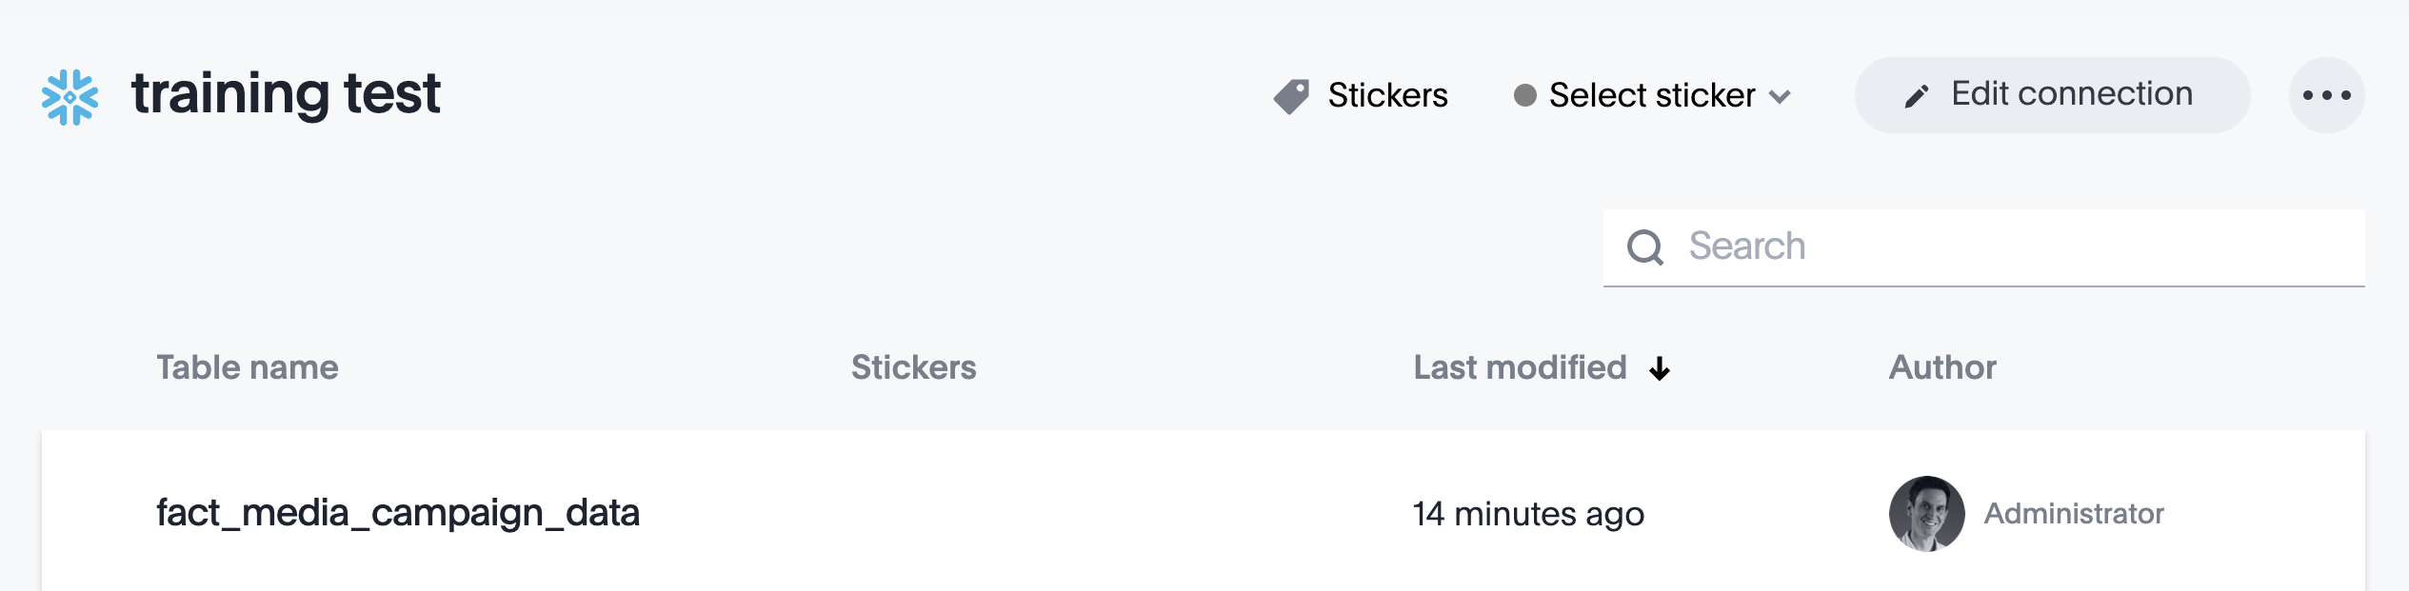
Edit the connection
If there are changes to tables or columns in the source database, you must edit the connection in ThoughtSpot. These changes will not update automatically.
For this reason, it is a best practice to finalize your data model as much as possible before creating the connection!

Slide 14
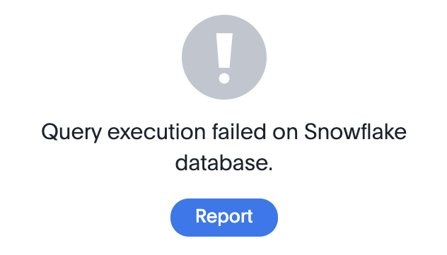
Edit the connection (cont.)
Edit the connection in ThoughtSpot to add, remove, re-name, or edit tables and columns that were altered in the source database.
If there are existing Answers or Pinboards in ThoughtSpot that contain a field that has been dropped in the source database, it will report an error. Update these objects to remove the dropped table or columns.
Notes:
If a table is added to the source database after the initial connection, any additional join relationships will need to be added in the Schema tab of ThoughtSpot.
If a table name changes in the source database, the name must be updated in ThoughtSpot.
When a column is removed from a linked table in the source database, you must edit the connection from the ThoughtSpot UI to remove the field, and there will be no warning of dependent objects. These objects must be manually edited to remove the dropped table or columns.

Slide 15
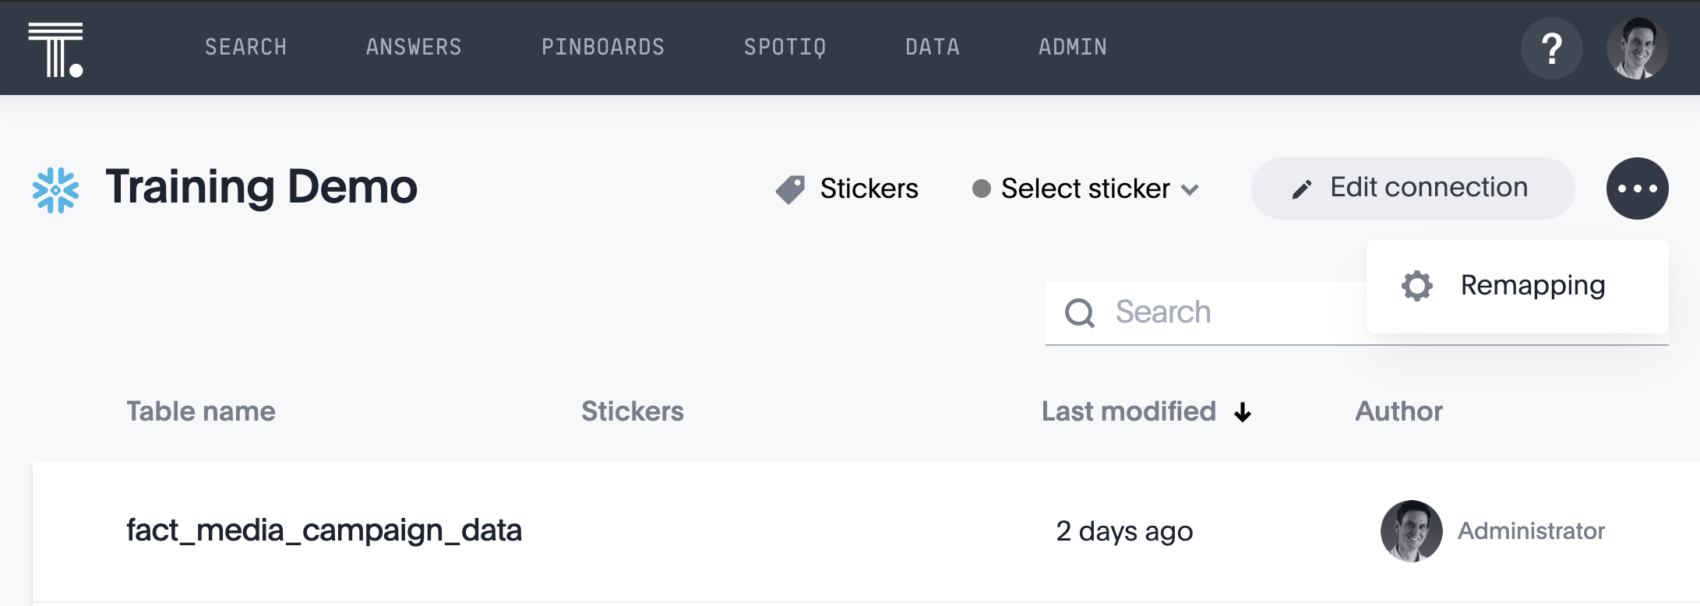
Remap a connection
You may also remap a connection by editing the mapping yaml file that was created when you added the connection. For example, you can remap the existing table or column to a different table or column in an existing database connection.
Notes:
ThoughtSpot recommends that you check the dependencies before and after you remap a table or column in a connection to ensure they display as intended.

Slide 16
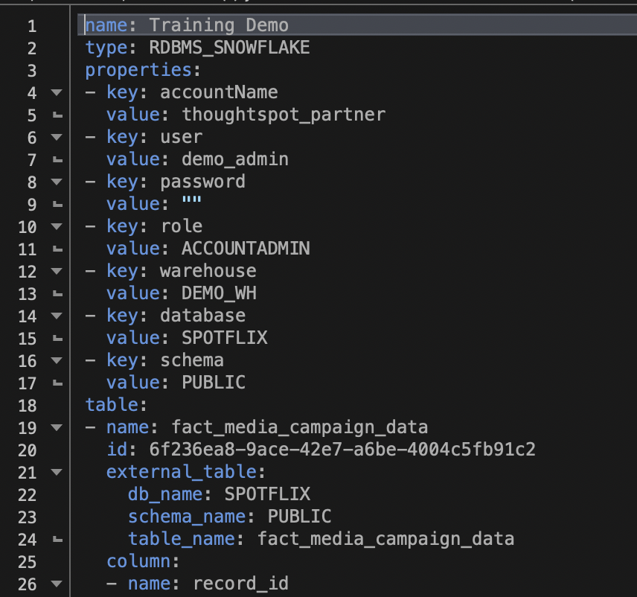
Remap a connection (cont.)
Edit this file to map a table or column to a different table or column in your source database.
Edit the file, save, and re-upload to ThoughtSpot to save these updates.
Notes:
ThoughtSpot recommends that you check the dependencies before and after you remap a table or column in a connection to ensure they display as intended.

Slide 17
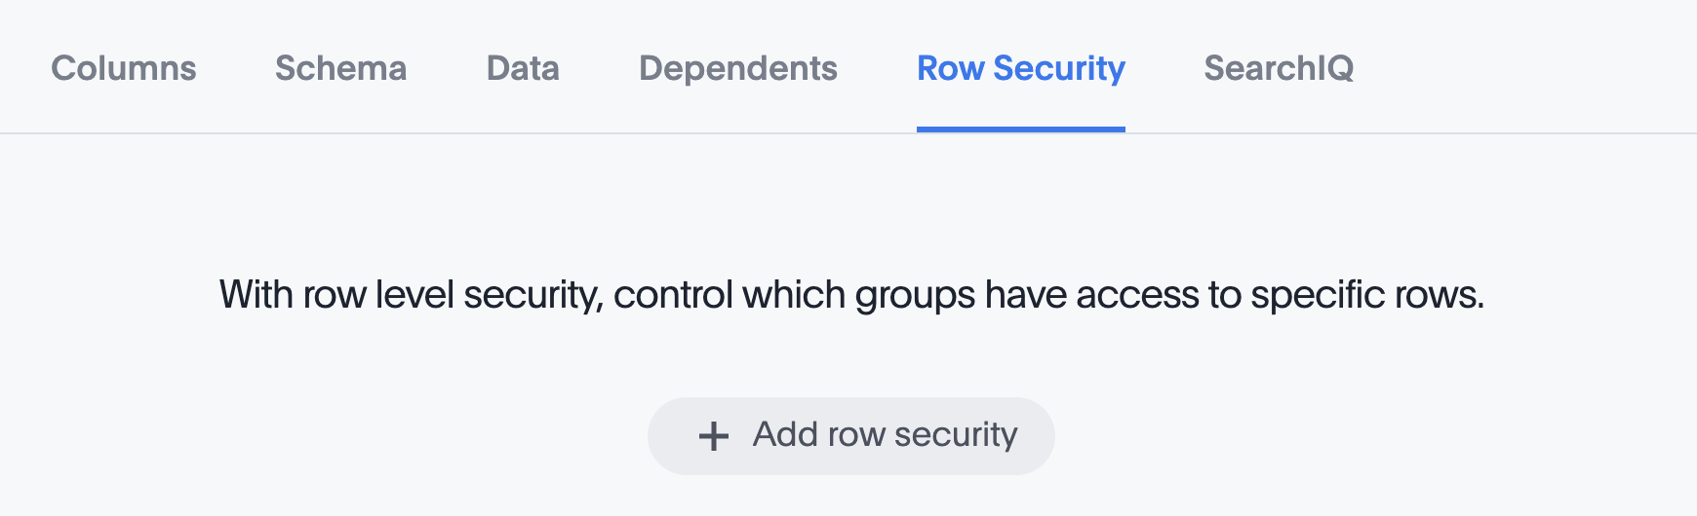
Security Considerations
Row Level Security must be set in ThoughtSpot, as user’s security permissions from the source database are not carried over.
User/group synchronization and object-level security are applied in the same way as with any ThoughtSpot implementation.
The JDBC connection to the source database is encrypted.
Notes:
Column indexing may happen daily or hourly, and only then will the RLS rules also apply to those search suggestions.
In an Embrace connection, ThoughtSpot does not cache data from source database. If the source database caches data, the search results may be faster

Slide 18
Feature Matrix Comparison
Feature Name | Falcon | Embrace 6.3
Simple & Complex searches like Versus, Inline Sub-querying, Growth | Yes | Yes
Search Suggestions for column names & column values | Yes | Yes
Headlines at the bottom that summarize tables | Yes | Yes
All Chart Types & Configurations | Yes | Yes
Spot IQ - Analyze | Yes | Yes
Spot IQ - Instant insights, Did you know?, Pinboard insight | Yes | No
Monitor | Yes | No
Table & Column Remapping through Scriptability | No | Yes
Custom Calendar | Yes | No
Materialized View | Yes | No
Notes:
Sage indexing (to get values for search suggestions) is done once a day (can be changed to hourly).
Deleting Columns : After specifying the connection. columns cannot be deleted from the table. Editing a connection can add a column but not delete it.

